Slide 1
TCS Verbal English pattern

Slide 2
Cloze Test
Sentence Correction
Selecting Words
Sentence Arrangement
Para jumble
Reading Comprehension
Error Identification
Error Correction
Spelling
Synonym
Word Selection

Slide 3
Cloze Test
1Today most businessmen are very worried. To begin with, they are not used to competition. In the past they sold whatever ...(1)... produced at whatever prices they chose. But ...(2)... increasing competition, customers began to ...(3)... and choose. Imports suddenly became ...(4)... available and that too at cheaper ...(5)...
1. A) IT B) HE C) THEY D) WE
2. A) WITH B) BY C) AFTER D) FROM
3. A) BUY B) TAKE C) PICK D) WANT
4. A) HARDLY B) EASILY C) FREQUENTLY D) CONVENIENTLY
5. A) COSTS B) RETURNS C) DIVIDEND D) PRICES

Slide 4
2. As a rule of thumb, a manned mission costs from fifty to a hundred times more than a comparable unmanned mission. Thus, for scientific exploration alone, ...(1)... missions, employing machine intelligence, are ...(2)... However, there may well be ...(3)... other than scientific for exploring ...(4)... social, economic, political, cultural or ...(5)...
A) MANNED B) UNMANNED C) SPACE D) LUNAR
A) LIKED B) WANTED C) USED D) PREFERRED
A) REASONS B) CAUSES C) CLUES D) OBJECTS
A) MOON B) SUN C) SPACE D) MISSION
A) CASUAL B) HISTORIC C) HISTORICAL D) HISTRIONIC

Slide 5
3. The principal advantage in having a clear cut objective of business is that it does not derail; the enterprise does not stray ...(1)... the direct route that it has set for ...(2)... Enterprises with well defined objectives can conveniently undertake ...(3)... and follow long range development policies. Recognition of objectives ...(4)... the temptation to compromise long range ...(5)... for short term gains and improves coordination in work and consistency in policy.
A) FROM B) ON C) ALONG D) TOWARDS
A) OTHERS B) INDUSTRY C) ITSELF D) GOVERNMENT
A) PRODUCTION B) RESEARCH C) AUDIT D) APPRAISAL
A) INVITES B) DEFERS C) SHIFTS D) REMOVES
A) OBJECTIVES B) LOSES C) INTERESTS D) PROFITS

Slide 6
4. Let children learn to judge their own work. A child ...(1)... to talk does not learn ...(2)... being corrected all the time ...(3)... corrected too much, he will ...(4)... talking. He notices a thousand times a day the difference between the ...(5)... he uses and the language those around him use.
1. A) ENDEAVORING B) LEARNING C) EXPERIMENTING D) EXPERIENCING
2. A) IN B) ON C) BY D) TO
3. A) UNLESS B) BEING C) UNTIL D) IF
4. A) STOP B) HALT C) AVOID D) SHUN
5. A) SPEECH B) LANGUAGE C) TALK D) SKILL

Slide 7
5. His talk used to be full of wit and humours. He liked reading.He was a ...(1)... reader and would pore over books ...(2)... a wide range of interest as ...(3)... he got them. He had ...(4)... a standing order to two bookshops ...(5)... city.
A) VORACIOUS B) FERVENT C) ANXIOUS D) ENTHUSIASTIC
A) COVERING B) BARRING C) INCLUDING D) CONTAINING
A) FIRMLY B) QUICKLY C) SOON D) URGENTLY
A) OFFERED B) PROCLAIMED C) INTIMATED D) GIVEN
A) AT B) IN C) WITHIN D) INSIDE.

Slide 8
SENTENCE CORRECTION
1. The small child does whatever his father was done.
A)Has done B) did C) does D) had done E) no error
2.The man to who I sold my house was a cheat.
To whom I sell B) to who I sell C) to whom I sold
D) who was sold to E) no error.
3. They were all shocked at his failure in the competition.
A) were shocked at all. B) had all shocked at C) had all shocked by D) had been all shocked by E) no error.
4. He is too important for tolerating any delay.
A) to tolerate B) to tolerating C) at tolerating
D) with tolerating E) no error.

Slide 9
5. The population of Tokyo is greater than that of any other town in the world.
A) greatest among any other B) greater than all other
C) greater than those of any other. D) greater than any other E) no correction required.
6. The performance of our players was ratherworst than I had expected.
A) bad as I had expected B) worse than I had expected C)worst than expectation D) worse than was expected E) no error.

Slide 10
SELECTING WORD

Slide 11
1. All the faculty members except HoD _________ to the new curriculum proposed by Prof. Bhasin.
Agrees B) agreed C) proceed D) satisfied.
2. The tiring trip to hills of Shivpuri _____ the entire group exhausted.
A) cancelled B) failed C) left D) remains.
3. It is sad, the way she has _______ a once a life time opportunity.
A) squandered B) missed C) sacrificed D) remains calm.

Slide 12
4. There was ______ in the country when their cricket team won the world cup. A) happiness B) energy C) shock D) jubilation.
5. The experiment lead to emission of ______ vapor, which resulted in immediate termination of the research.
Noxious B) non toxic C) innocuous D) bland
6. When we found her _____ the romantic ruins and back packers, she was busy chasing dogs. A) amidst B) among C) between D) beyond E) outside.
7. A true salesperson needs to be ready for any argument about his product, for which he must be ______ with it inside out. A) known B) amazed C) clear D) acquainted.
8. ______ being poor, Kaveri still dresses more appropriately than most of her group mates. A) despite B) although C) since D) however.
9. This hotel has a good ____service. They park the cars safely. A) bellboy B) callboy C) valet D) doorman.

Slide 13
10. As wild orchids plants are believed to have medicinal value, their populations in forests have been ___ ruthlessly. A) guarded B) picked C) reforested D) plundered.
11. The teacher must _______ the unique style of learner in order to ______ it to the desired knowledge.
Advocate – direct B) perpetuate – develop C) appreciate – focus D) discover – harness.
12. If you are an introvert, you _____ to prefer working alone and, if possible, will _____ towards projects where you can work by yourself or with as few people as possible. A) like – depart B) advocate – move
c) tend – gravitate D) express – attract.

Slide 14
Sentence Formation

Slide 15
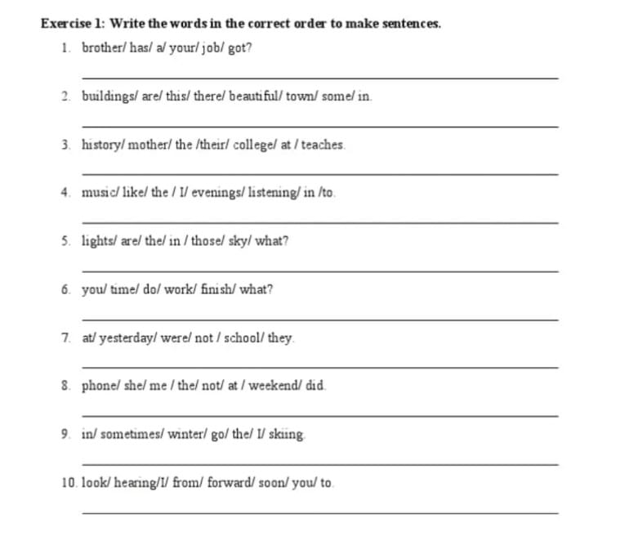

Slide 16
Sentence Arrangement

Slide 17
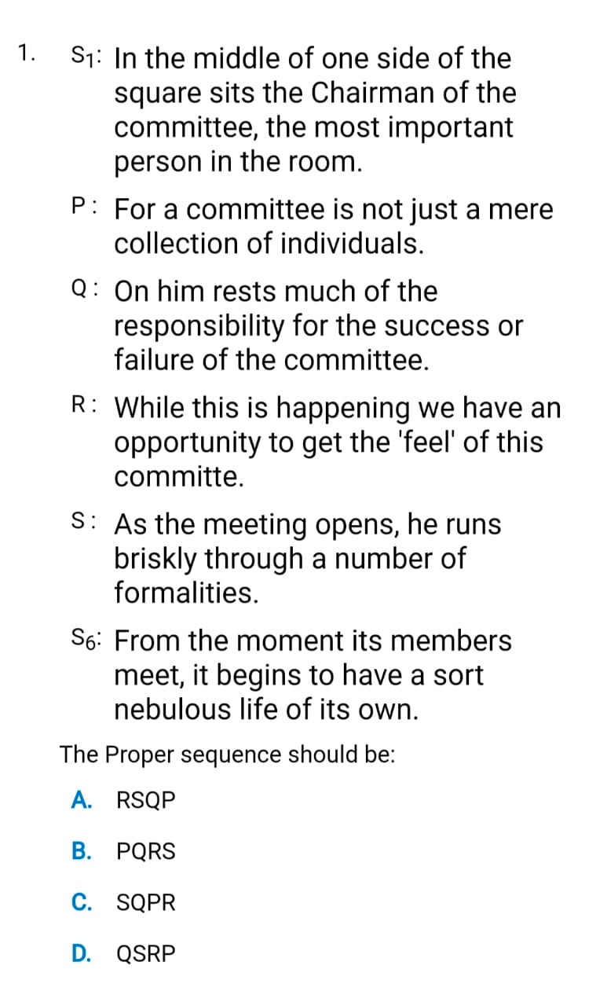

Slide 18
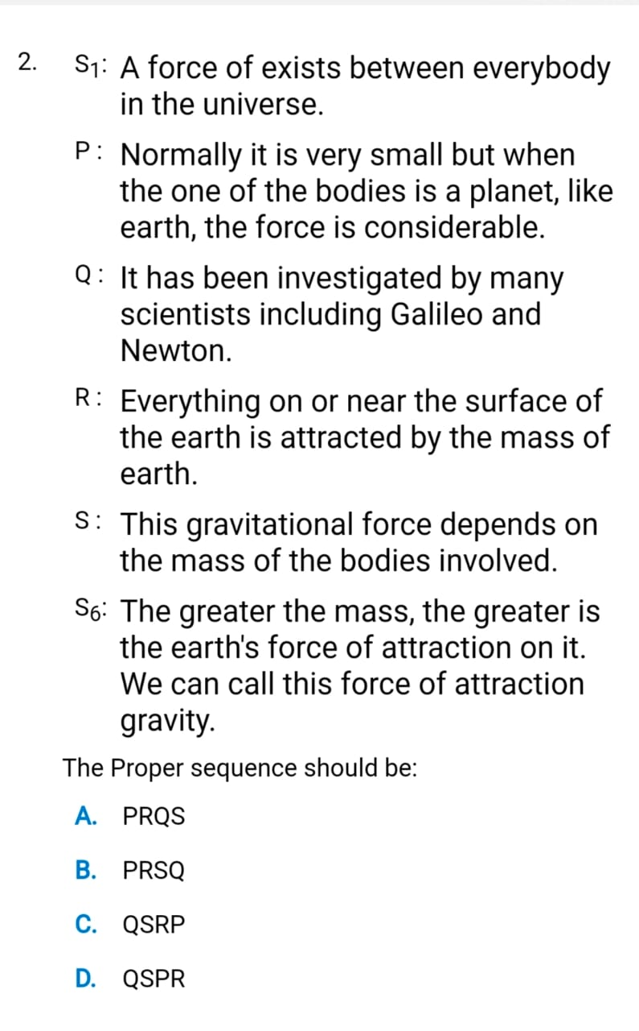

Slide 19
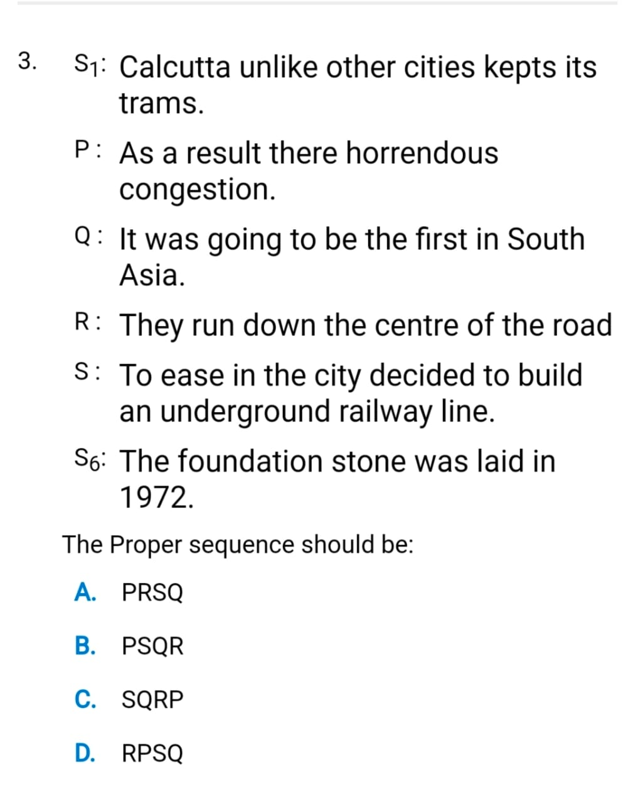

Slide 20
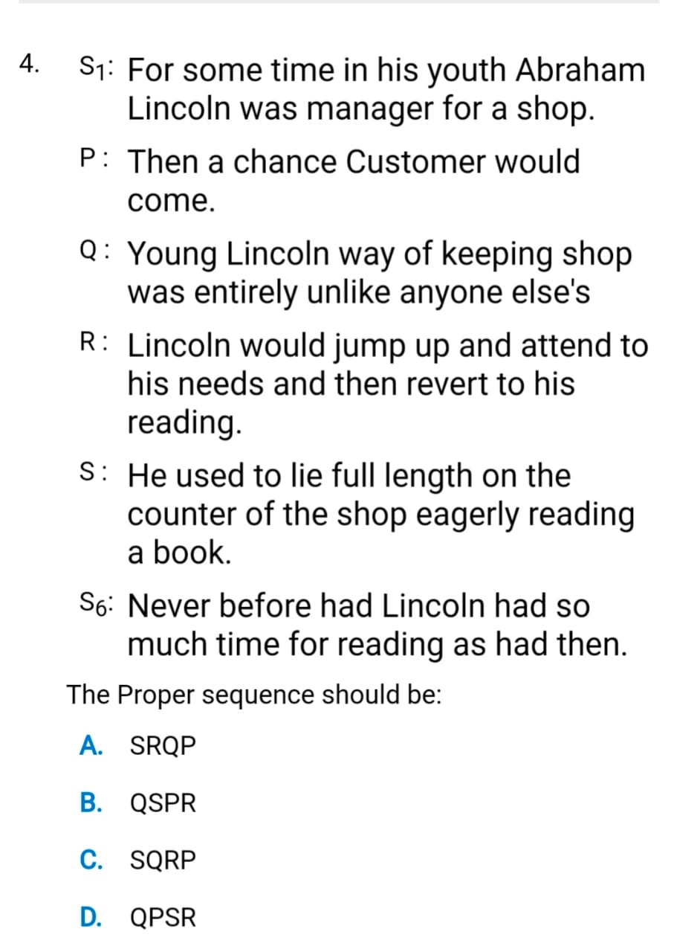

Slide 21
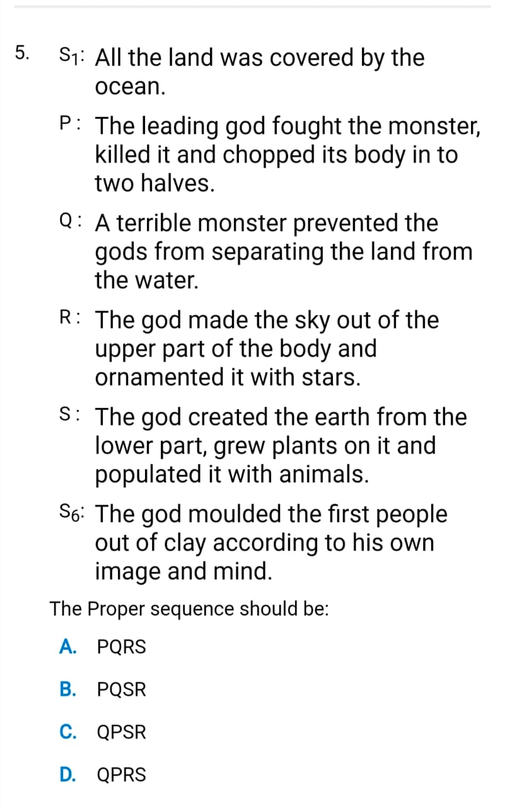

Slide 22
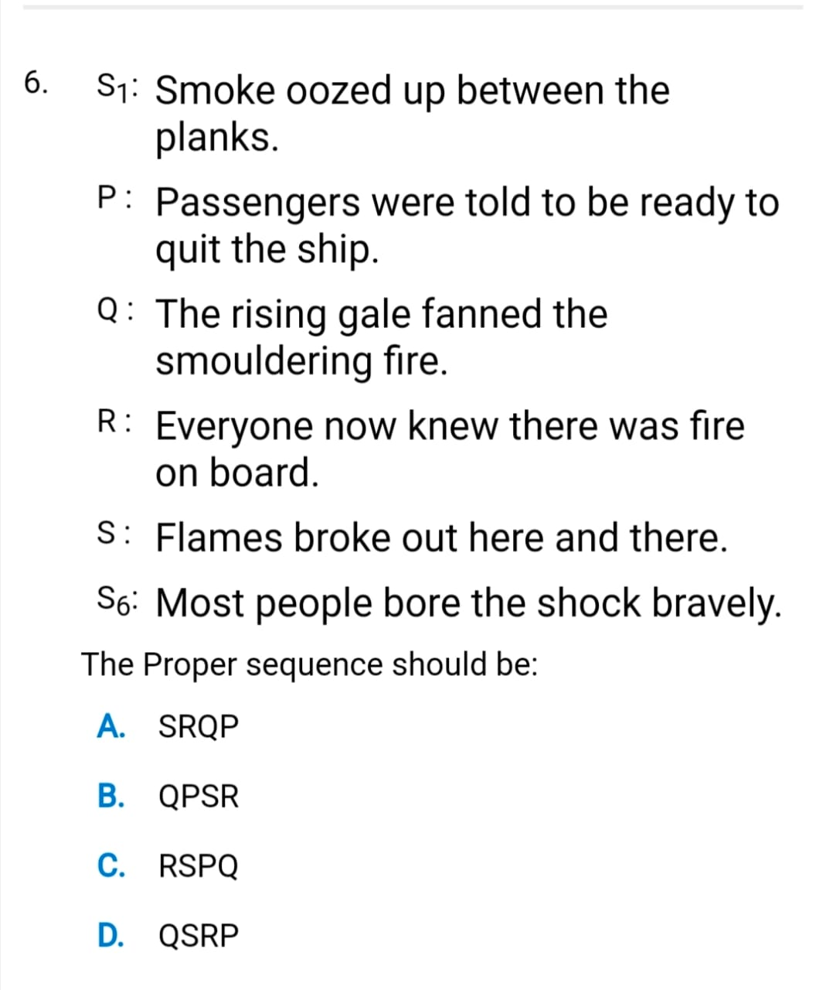

Slide 23
Reading Comprehension

Slide 24
Passage 1
“Uncle” said Luke to the old Sean “You seem to be well fed, though I know no one looks after you. Nor have I seen you leave your residence at any time. Tell me how you manage it?” “Because” Sean replied, “I have a good feed every night at Emperor’s orchard. After dark, I go there myself and pick out enough fruits to last a fortnight.” Luke proposed to accompany his uncle to the orchard. Though reluctant because of Luke’s habit of euphoric exhibition of extreme excitement, Sean agreed to take him along. At the orchard while Sean hurriedly collected the fruits and left, Luke on the other hand at the sight of unlimited supply of fruits was excited and lifted his voice which brought Emperor’s men immediately to his side. They seized him and mistook him as the sole cause of damage to the orchard. Although Luke reiterated that he was a bird of passage, they pounded him mercilessly before setting him free.

Slide 25
1) What does “bird of passage”; mean in the context of the given passage? a. There was a bird in the orchard
b. Other people stole from the orchard
c. Emperor knew him personally
d. He did not visit orchard regularly
e. Bird’s song alerted Emperor’s men
2) Which of the following can be inferred from the passage? a. Luke did not take good care of his uncle
b. Emperor was a wicked man
c. Lack of self-control had put Luke into trouble
d. Luke had a habit of speaking loudly
e. Orchards are meant for the public
3) How often did Sean visit the orchard? a. Daily b. Weekly c. Once in a month d. Every day after midnight e. Never

Slide 26
4) Choose the word which is most nearly the same in meaning as the word “Reluctant” used in the passage. a. Against b. Resistant c. Opposed d. Disinclined e. None of these
5) Read the following passage carefully and answer the questions that follow. You must choose your answers out of the four given choices. Why did Sean leave after collecting the fruits? a. He feared that the bird’s song would awaken the Emperor
b. To avoid getting caught by Emperor’s men
c. He saw the Emperor’s men approaching
d. He was afraid of the dark
e. He wanted to leave Luke also

Slide 27
Error Identification & Correction

Slide 28
Error Identification
1.Sheela hearing the news of mars mission whichwas initiated by ISRO.
A. Hearing B. of C. which D. was E. no error
2. Turn right by the crossroads when you reach it by car.
Turn B. by C. reach D. no error.
3. Ram stopped to see if he could picked up the 50 Rs note.
Stopped B. see C. picked D. no error.
4. Although Raja jumped aside, butthe stone hit him.
Jumped B. but C. the D. hit E. no error

Slide 29
5. Work as quick as you can but as carefully as possible when you take the blood test.
As quick B. as carefully C. take D. no error.
6. Raghu received a watch which he like to wear always.
Received B. which C. like D. always E. no error.
7. I have purchased an iPhone which is very expensive.
Purchased B. which C. very D. no error.
8. Neena saw the deaf man crossed the crowded road withoutany help.
Saw B. crossed C. without D.any

Slide 30
9.Tommy waggedit’s tail when he saw me approaching.
Wagged B. it’s C. saw
10. After few moment the man opened the car window and looked out curiously.
Moment B. opened C. and D. no error.
11. Plugthe right connector to the socket will saves the appliance.
A. Plug B. the C. socket D. saves

Slide 31
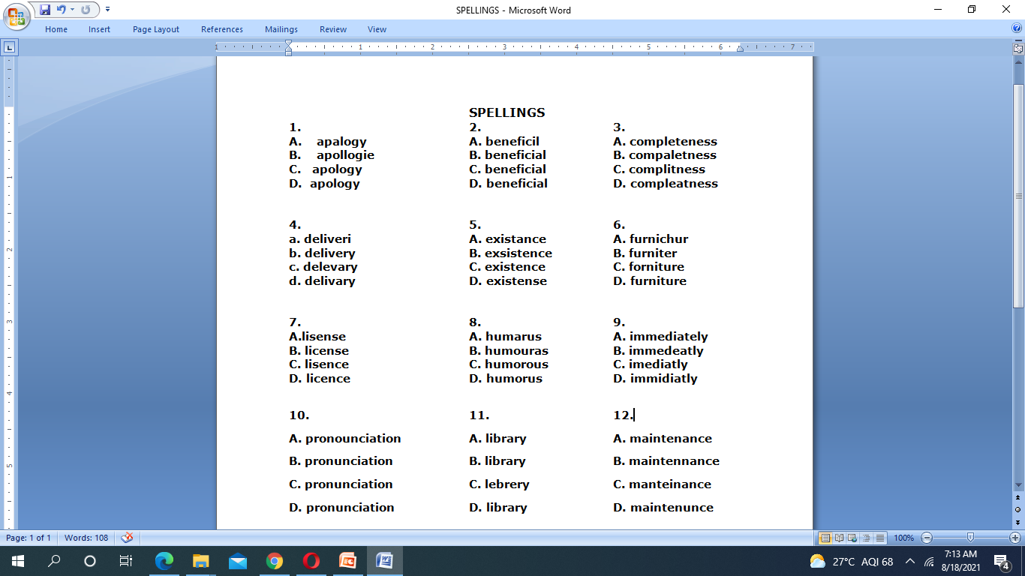
Spell check

Slide 32
Synonyms

Slide 33
Synonyms
1.VITUPERATE
A. abuse
B. rebuke
C. praise
D. retort

Slide 34
1.VITUPERATE
A. abuse
B. rebuke - scolding, attack
C. praise
D. retort - reply or acknowledge

Slide 35
2. An extremely deep crack or opening in the ground
A.Chasm
B.Aperture
C.Ditch
D.Pit

Slide 36
2. An extremely deep crack or opening in the ground
A.Chasm - deep hollow,abyss
B.Aperture
C.Ditch
D.Pit
Answer: A

Slide 37
3.CONVIVIAL
A.prodigal
B.serious
C.disloyal
D.hostile
E.friendly

Slide 38
CONVIVIAL - Occupied with or fond of the pleasures of good company
A.prodigal - Recklessly wasteful
B.serious
C.disloyal
D.hostile - Characterized by enmity
E.friendly

Slide 39
4. Vicissitude
a. sorrows b. misfortunes c. changes
d. surprises
5. Pandemonium
a. greatjoy b. utterconfusion c. loudnoise
d. bigcrowd

Slide 40
ans
4. Vicissitude - A variation in circumstances or fortune at different times in your life or in the development of something
a. sorrows b. misfortunes c. changes
d. surprises
5. Pandemonium - A state of extreme confusion and disorder
a. greatjoy b. utter confusion c. loudnoise
d. bigcrowd

Slide 41
6. Garrulity
a. credulity b. speciousness c. Loquaciousness
7. Magniloquent
a. Amusing b. Humorous c. Intelligent
d. Boastful

Slide 42
Ans
6. Garrulity - The quality of being wordy and talkative
a. credulity
b. speciousness -An appearance of truth that is false or deceptive; seeming plausibility
c. Loquaciousness- The quality of being wordy and talkative
7. Magniloquent
a. Amusing b. Humorous c. Intelligent
d. Boastful

Slide 43
All the best

